Slide 1
LGBTQ Webcomics
Yaoi North 2016
Gryvon, Lisa Nani, Kateifer

Slide 2
Links and slides
YaoiNorth.com
Related Media Webcomics
http://www.yaoinorth.com/related-media/webcomics/
Past Events Past Panels Downloads
http://www.yaoinorth.com/panelists/downloads/

Slide 3
Where to find new comics?
Tumblr
Patreon
Rec Lists
Magic! Who knows?

Slide 4
Avialae (18+)
Comic: http://www.misslucidcomics.com/avialae/
Twitter: @llllucid
Patreon: https://www.patreon.com/lucid
$1, $5, $10, and $15 levels
Gannet used to be perfectly normal. Sure, he was stuck in a homophobic hellhole in the middle of nowhere, but he was normal. Then he woke up one morning to find a freakish set of wings sprouting from his back. With no one but his wannabe ornithologist neighbor, Bailey, to confide in, Gannet now must go through the painful and bloody process of growing wings.

Slide 5
Meet Gannet and Bailey

Slide 6
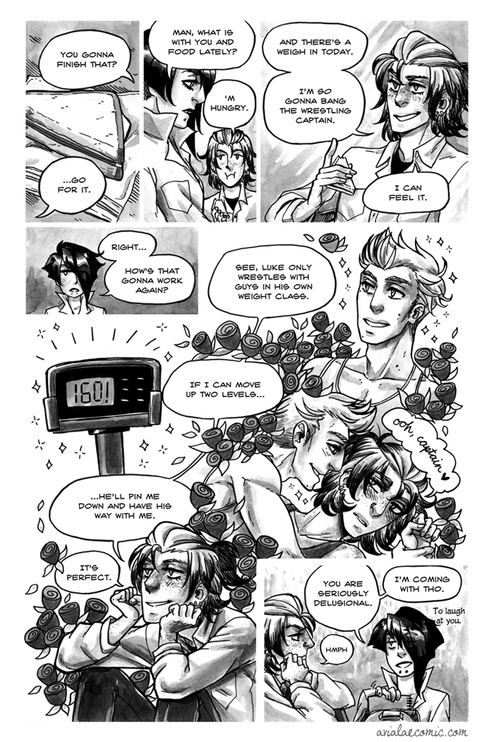

Slide 7
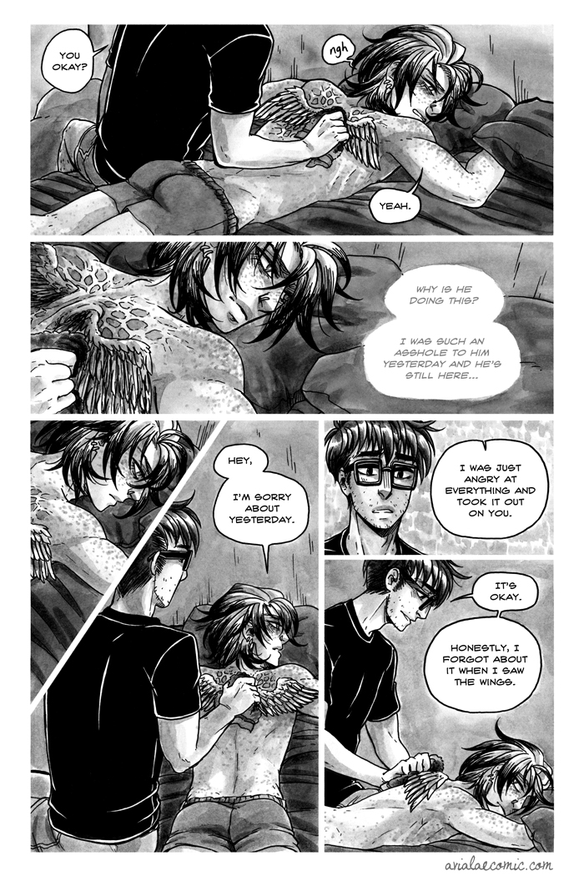

Slide 8
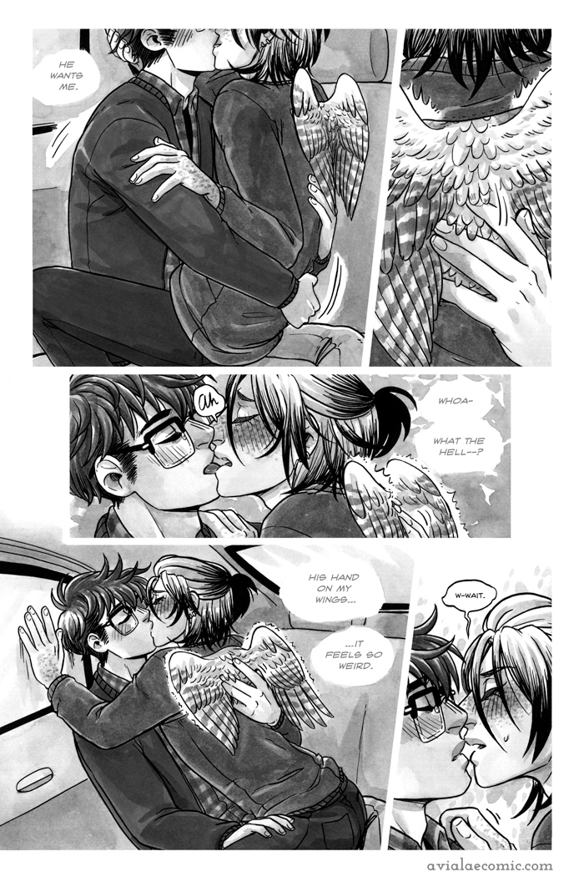

Slide 9
Check Please
Comic: http://omgcheckplease.tumblr.com/
Facebook: http://www.facebook.com/omgcheckplease
Twitter: @omgcheckplease
Patreon: http://www.patreon.com/ngoziu
$1, $3, and $5 levels
Eric Bittle—former Georgia junior figure skating champion, vlogger extraordinaire, and amateur pâtissier—is starting his freshman year playing hockey at the prestigious Samwell University in Samwell, Massachusetts. And it’s basically nothing like co-ed club hockey back in the South. For one? There’s checking.

Slide 10
Meet bitty and jack

Slide 11
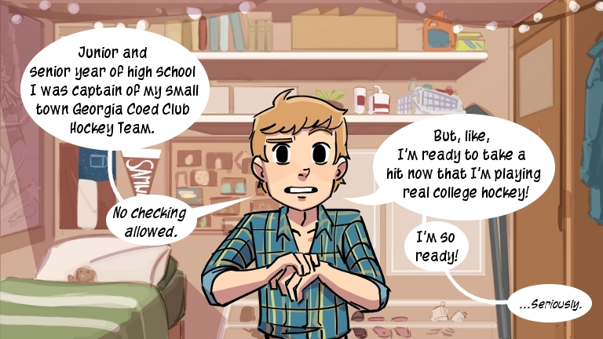

Slide 12
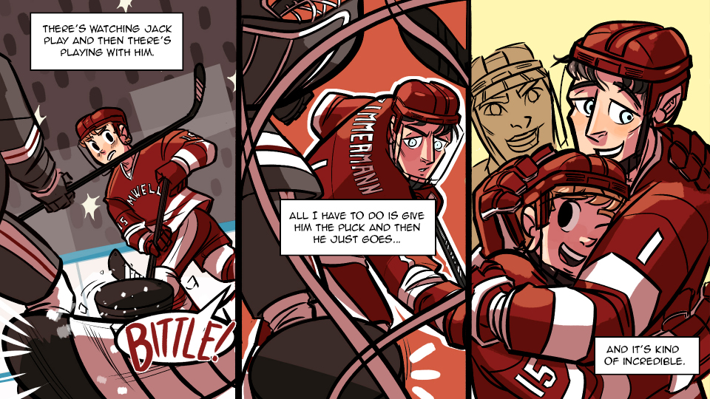

Slide 13
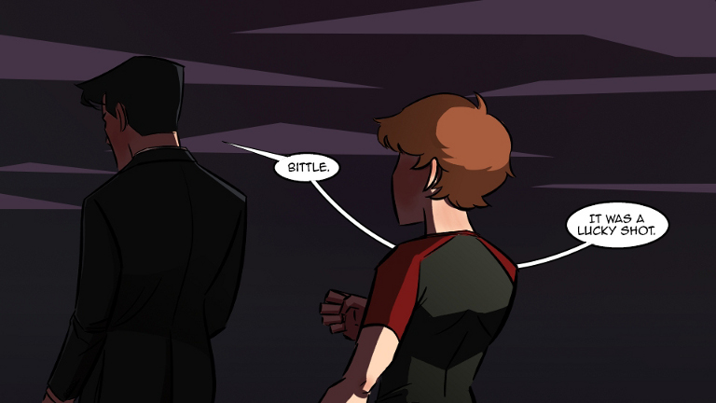

Slide 14
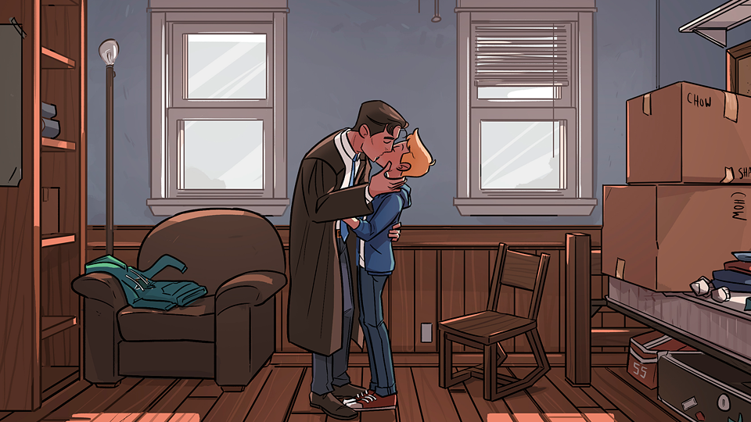

Slide 15
Curvy (18+)
Comic: http://www.urvy.org/
Twitter: @SylvanMigdal
A sexy sci-fi adventure comic for adults.

Slide 16
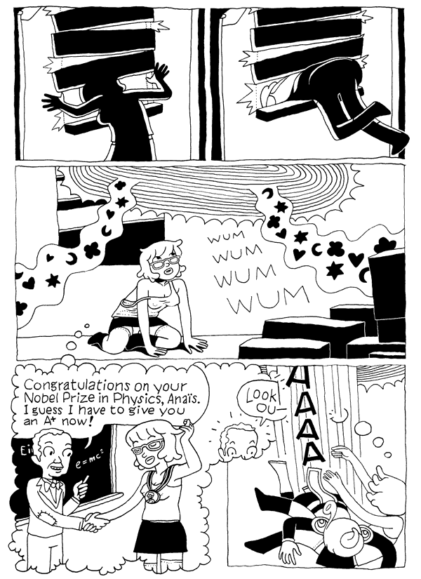

Slide 17
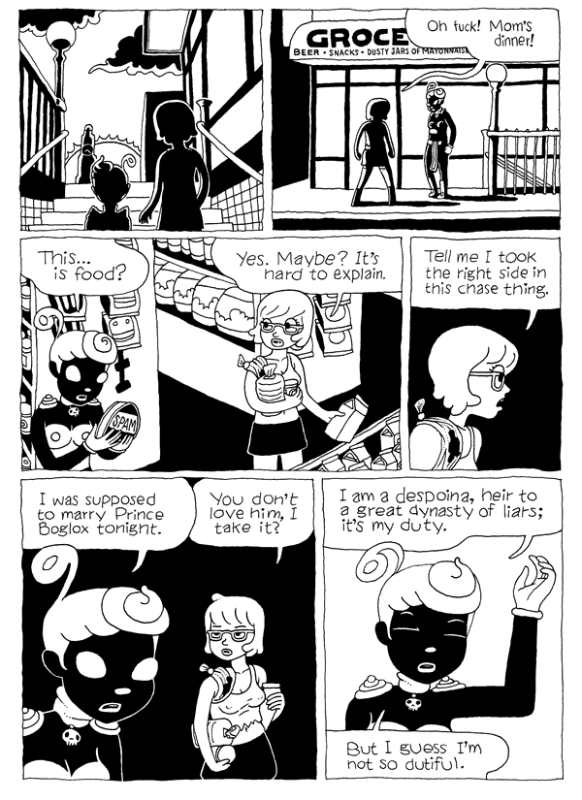

Slide 18
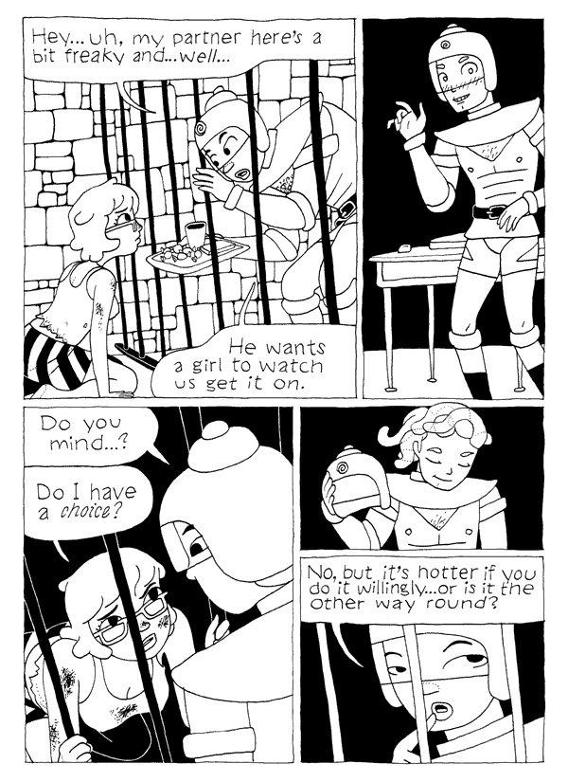

Slide 19
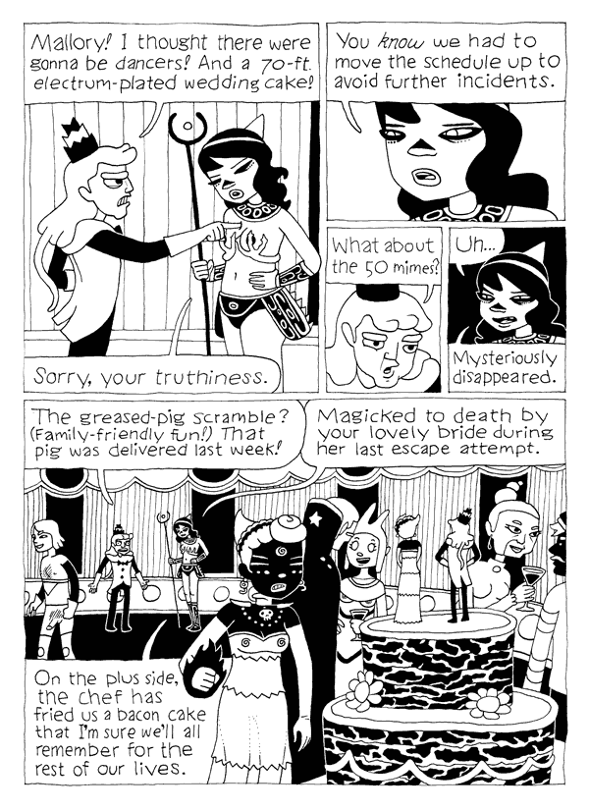

Slide 20
DAR
Comic: http://www.darcomic.com/
Twitter: @erikamoen
Facebook: https://www.facebook.com/ErikaMoenComics/
DAR! chronicles the six year long autobiographical story of Erika Moen, who starts out as a lost 20-year-old lesbian artist-wannabe in college who falls in love with a boy in England and the evolution that her sexual identity undergoes before winding up marrying him as a queer 26-year-old full-time cartoonist. Along the way there are many vignettes about sex, farts, the queer community, the Brits, vibrators and figuring out sexual identity.

Slide 21
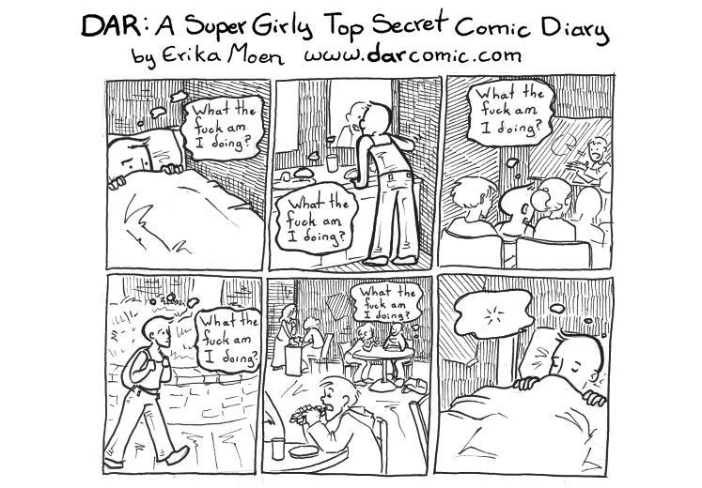

Slide 22
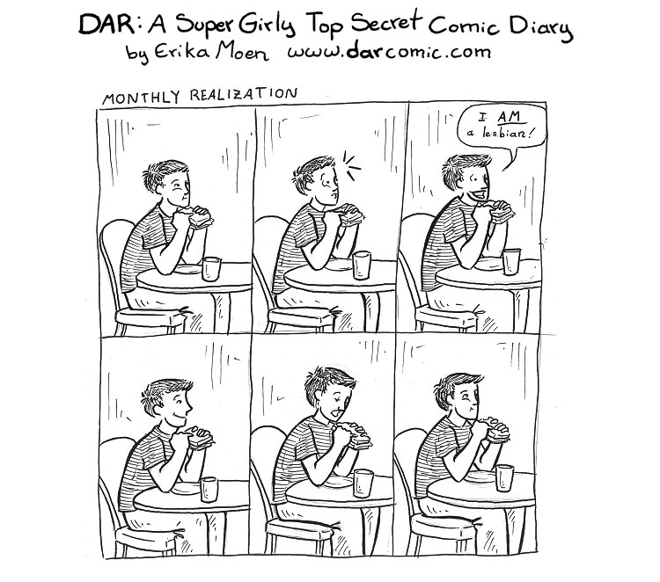

Slide 23
Girls with slingshots
Comic: http://girlswithslingshots.com/
Facebook: https://www.facebook.com/Girls-with-Slingshots-comic-41076594205/
Twitter: @dcorsetto

Slide 27
Monster pop
Comic: http://www.monsterpop.mayakern.com/
Patreon: http://www.patreon.com/mayakern
Tumblr: http://mayakern.tumblr.com/
Monster Pop! is a comic about two best friends and the slice of life adventures they share! Monster Pop! is set in an alternate Earth where monsters coexist with humans; sometimes they integrate well, sometimes they clash.

Slide 28
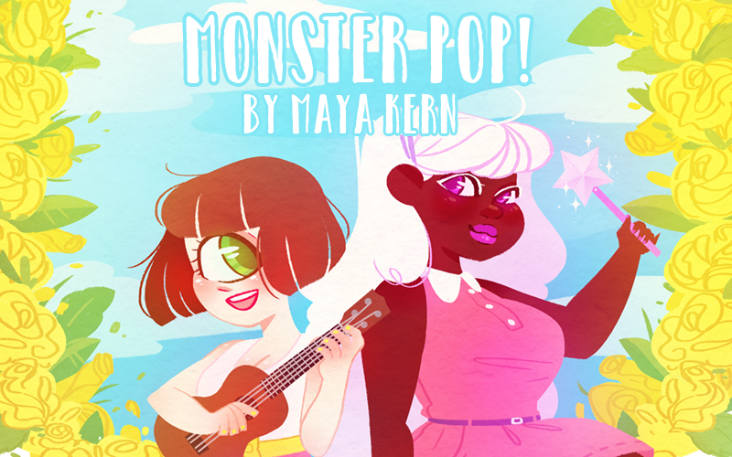

Slide 29
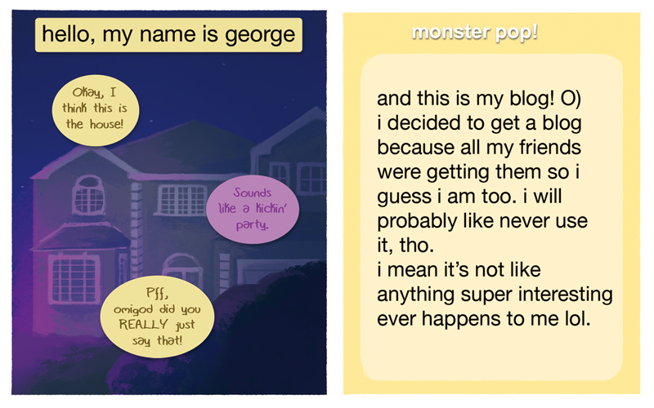

Slide 30
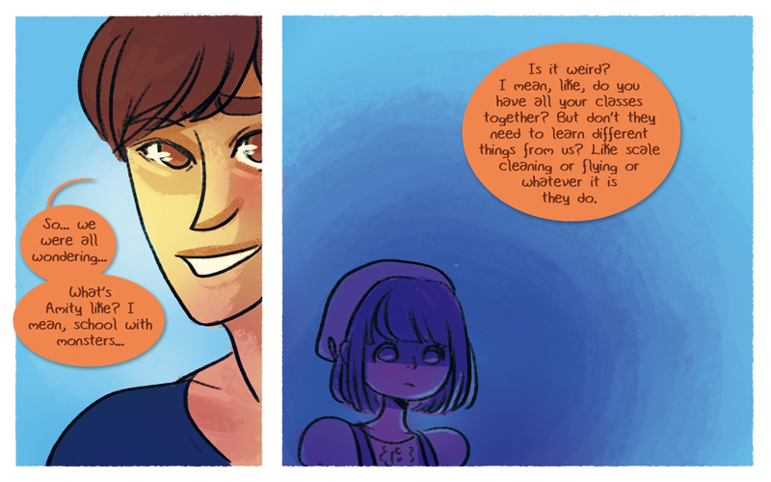

Slide 31
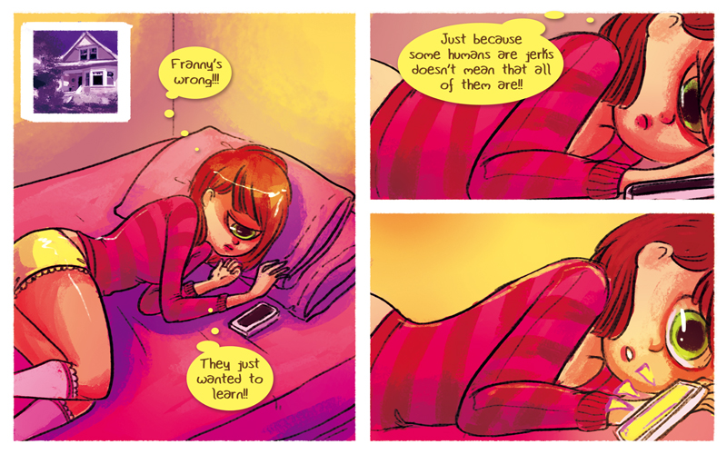

Slide 32
Noisome
Comic: noiso.me (English & Spanish)
Facebook: https://www.facebook.com/noisomewebcomic/
Twitter: @Tatouji
Tumblr: http://tatoujiji.tumblr.com/
Patreon: https://www.patreon.com/tatouji
$1/month for all bonus content
Psychiatrist Coen meets Noi, a writer with mental health issues who wants to be Coen’s new roommate.

Slide 33
Meet coen and noi

Slide 34
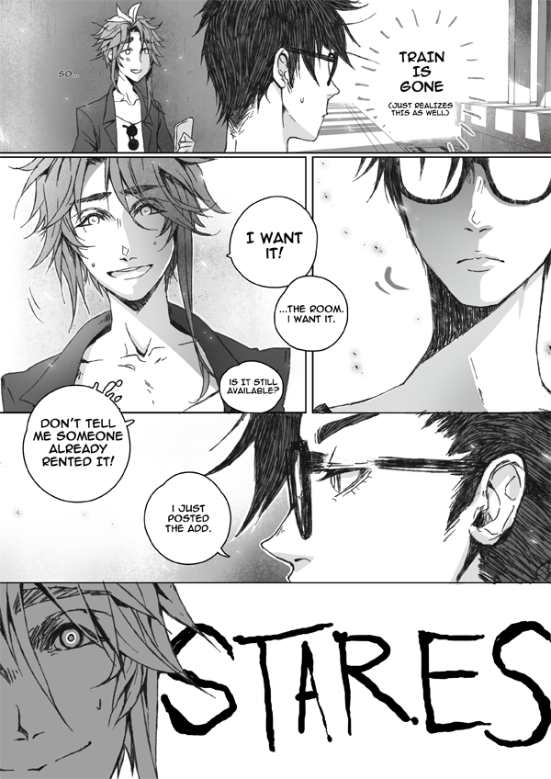

Slide 35
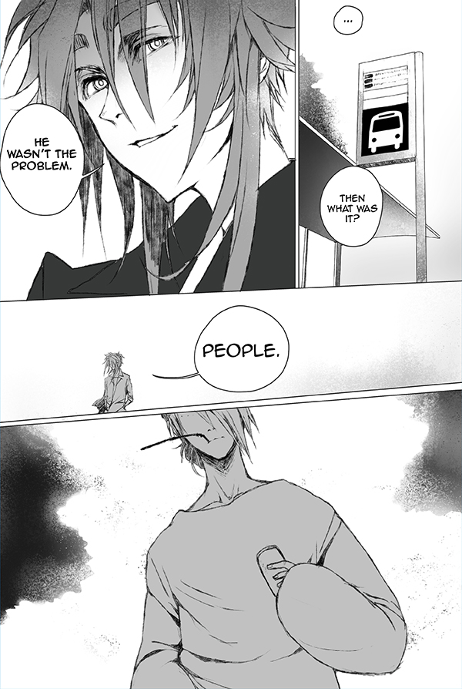

Slide 36
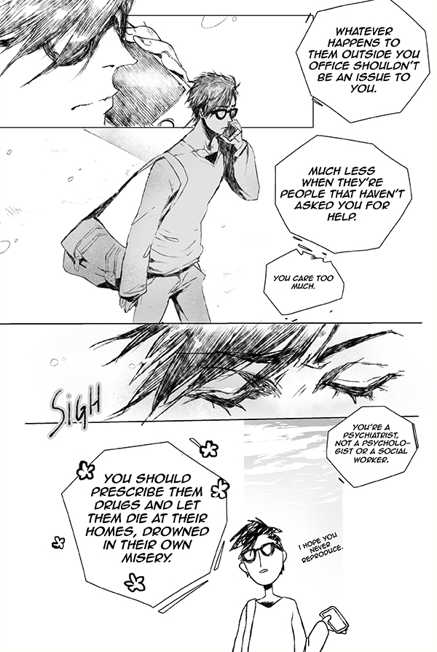

Slide 37
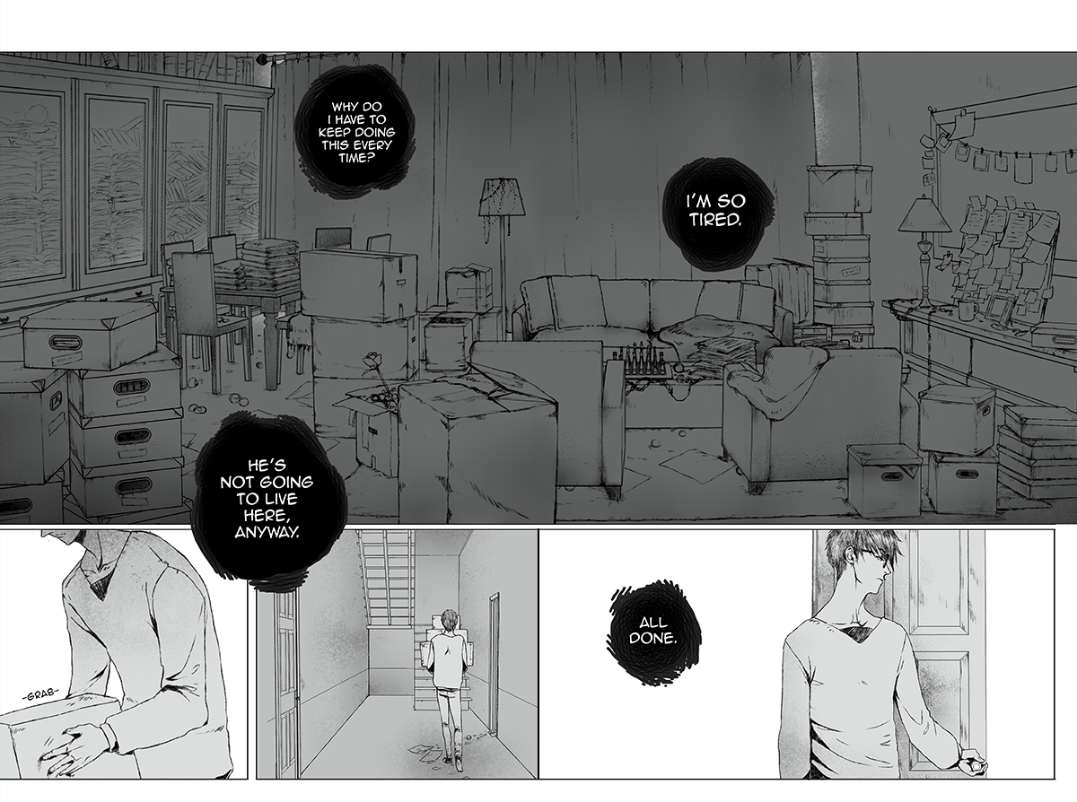

Slide 38
Sunstone
Comic: http://shiniez.deviantart.com/gallery/
Twitter: @stjepansejic
Comixology: https://www.comixology.com/Sunstone/comics-series/36148
Lisa, an aspiring novelist, knew from a young age that she enjoyed being tied up. Allison (aka Ally), an enthusiastic Domme, was exposed to BDSM when she broke the parental lock on her parent's television when she was a teenager. Lisa and Ally found each other on a message board online, and decided to take a step that would change both of their lives by deciding to begin a Domme/Submissive adventure together.

Slide 39
Meet Allison and Lisa

Slide 40
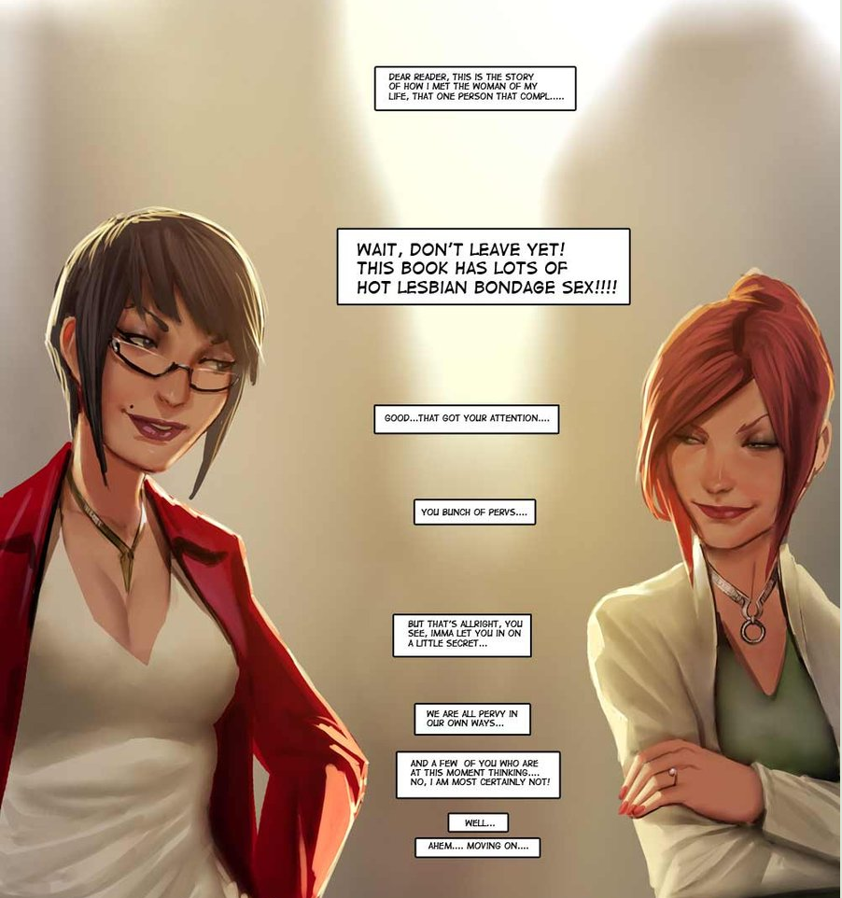

Slide 41
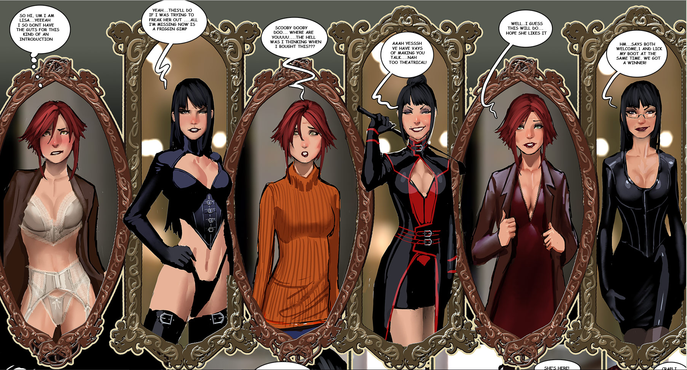

Slide 42
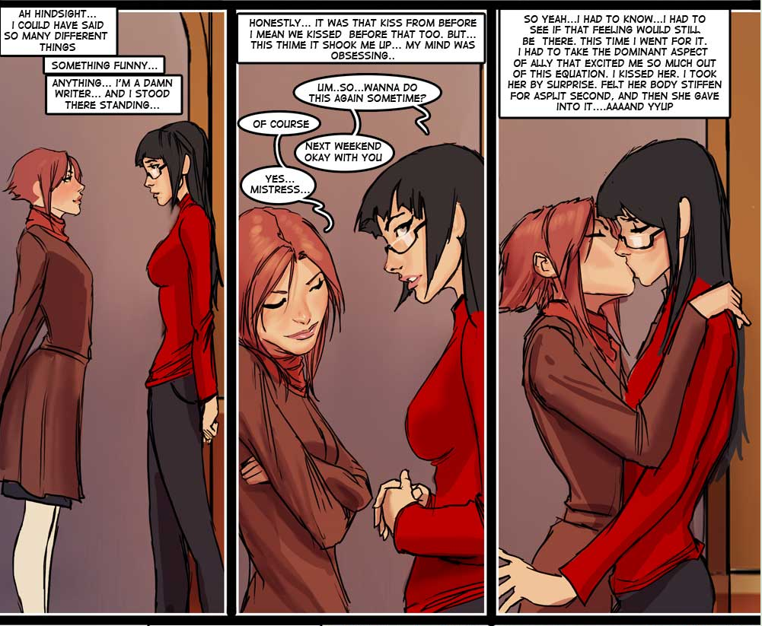

Slide 43
Tied in red
Comic: http://tied-in-red.smackjeeves.com/
Tumblr: http://tiedinred.tumblr.com
Twitter: @tiedinred
Patreon: https://www.patreon.com/tiedinred
$2, $5, $10.50, and $25 levels
Ned's a normal guy. All he wants is a normal life, with a normal job, and a normal wife, in the normal universe where those with soul mates are born with a red string on their pinkie.

Slide 44
Meet Doug and Ned

Slide 45
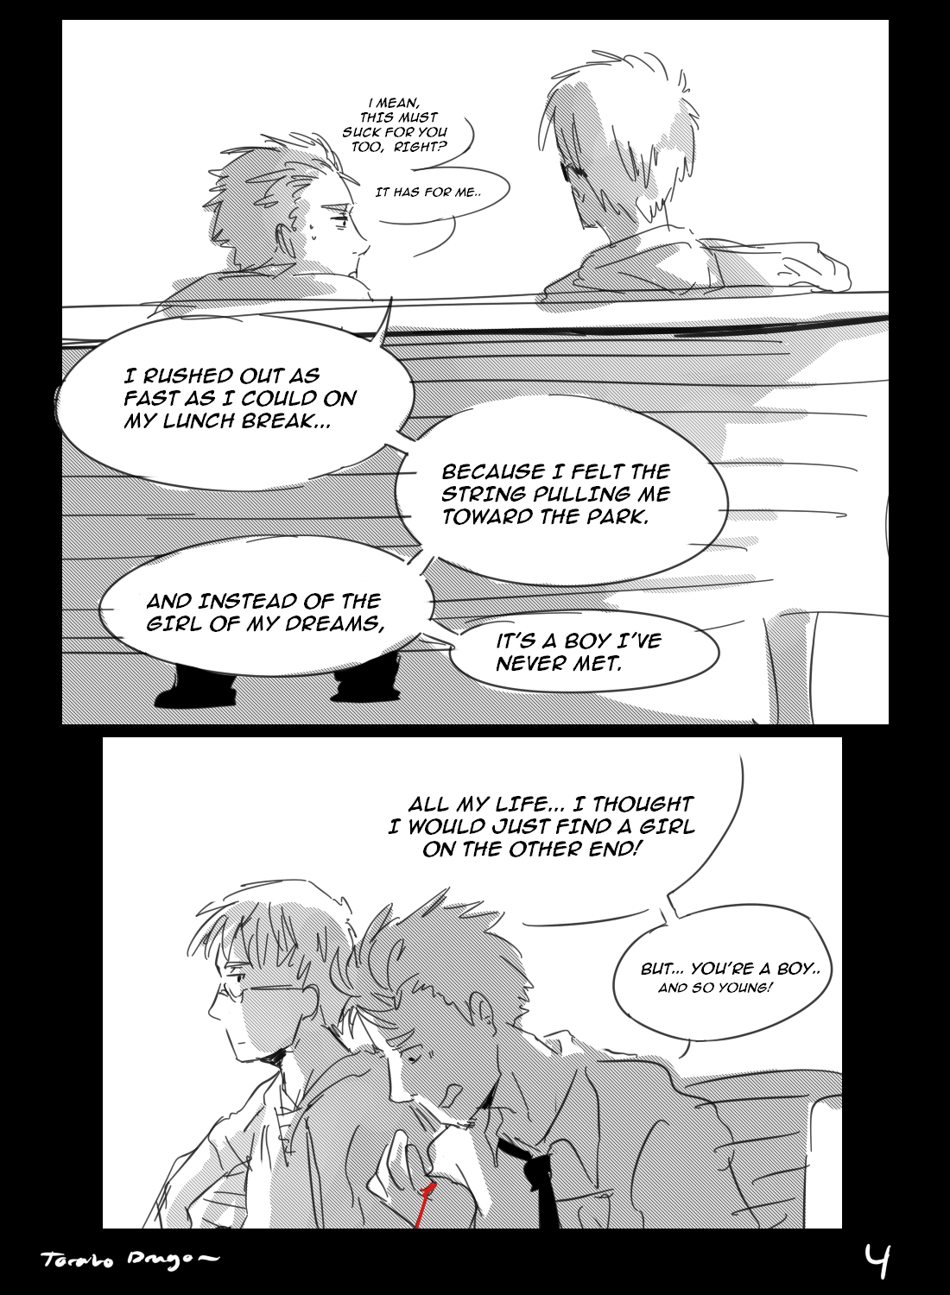

Slide 46
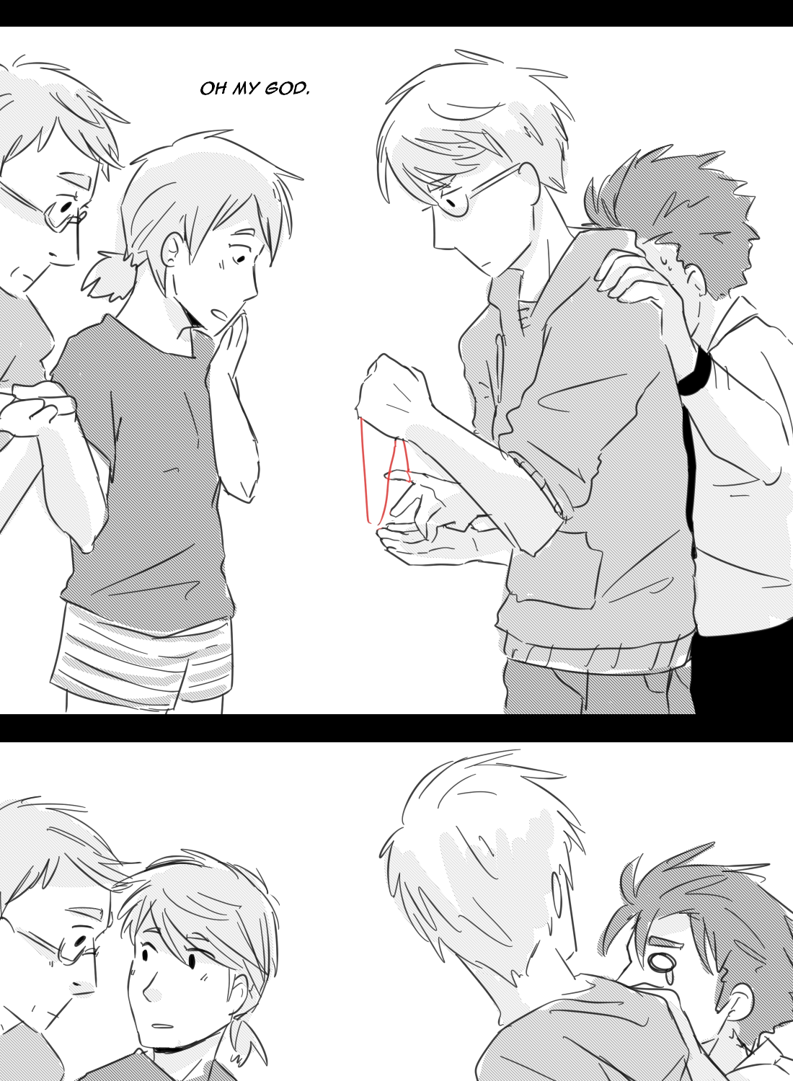

Slide 47
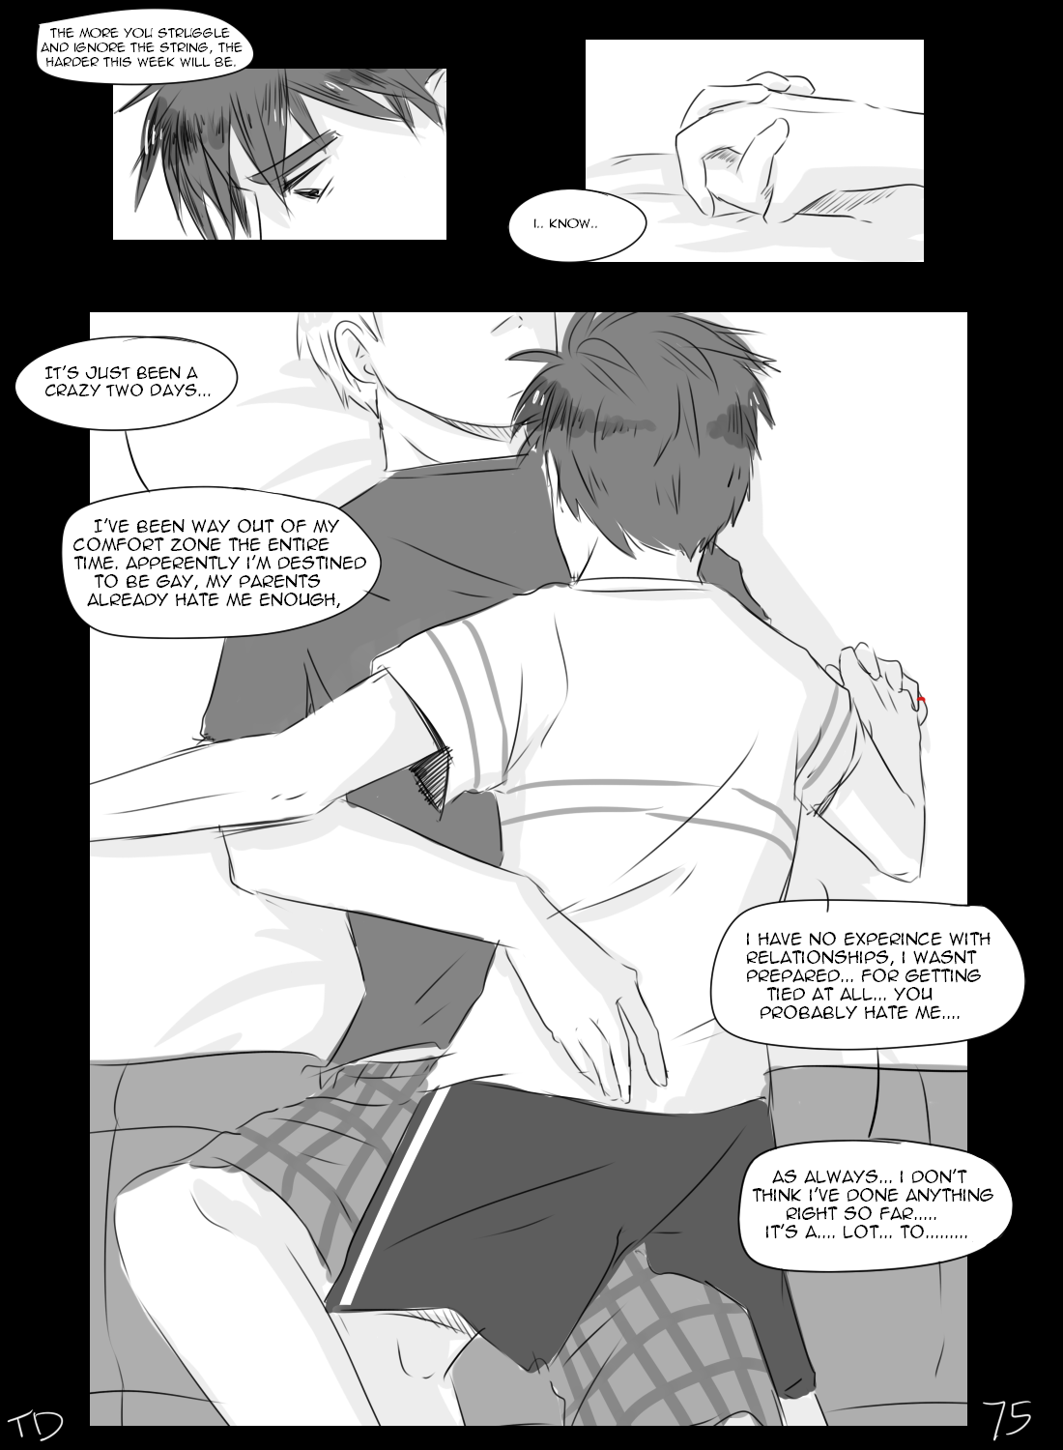

Slide 48
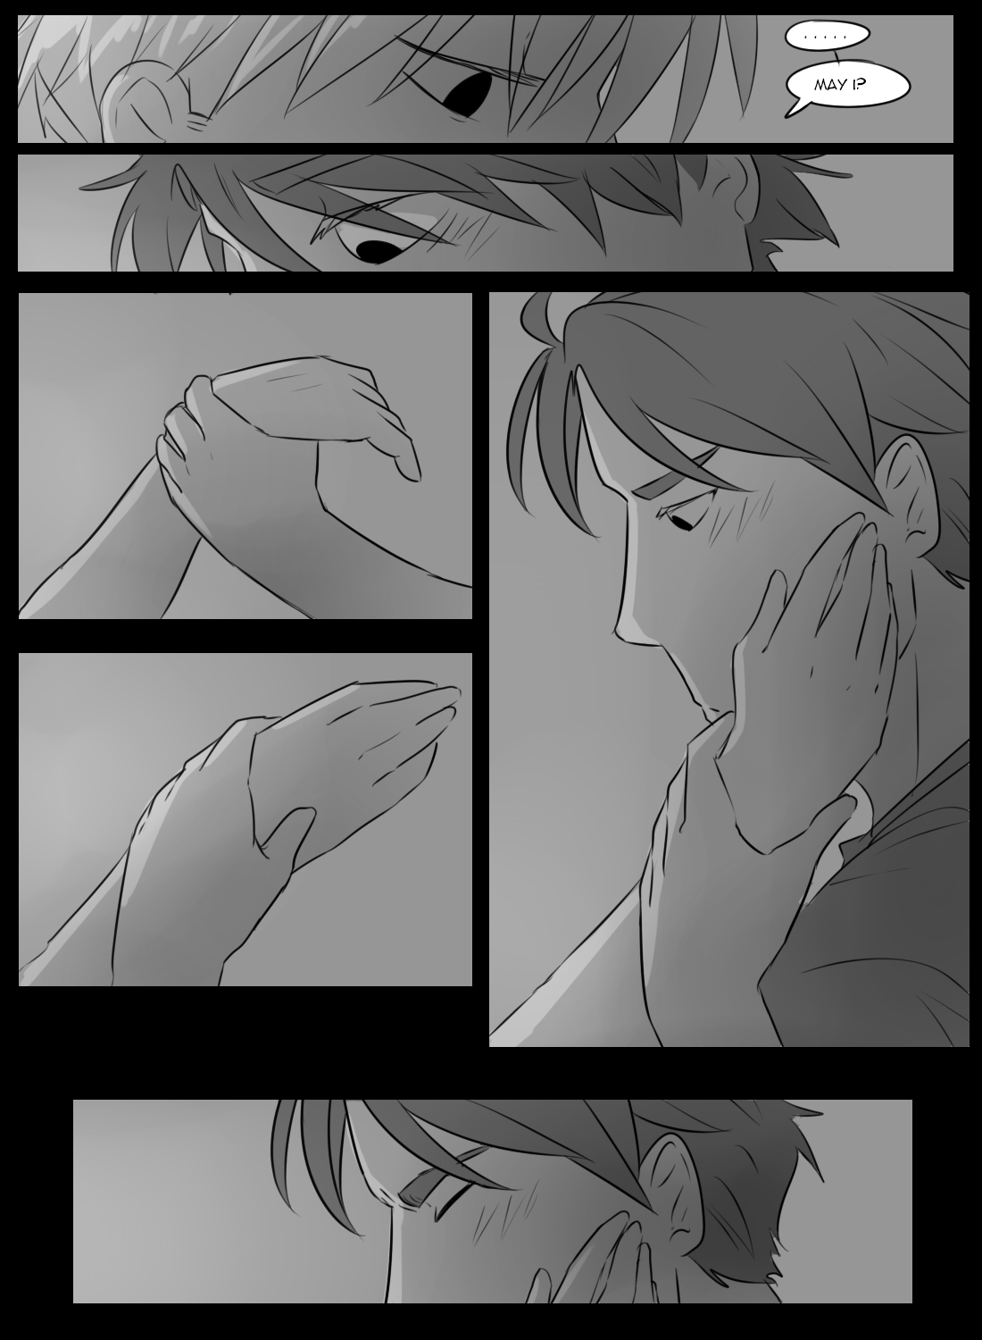

Slide 49
Victim: Gate of Spirits (18+)
Comic: http://victim.smackjeeves.com/
Tumblr: http://zombiecinnamon.tumblr.com/
Patreon: https://www.patreon.com/zccoffee
$1, $3, $5, $10, and $15 levels
The story is about people living in a small village near a huge primordial swamp and how they have to fight the dangers emerging from it. Then main character – Ivo – several years ago his best friend Dragosh went missing in the swamp. They say that people who disappear in the marshes are sure to die. But Ivo doesn’t lose hope. Can he find his friend when the armies of zombie animals are emerging from the swamps?

Slide 50
Meet ivo and dragosh

Slide 51
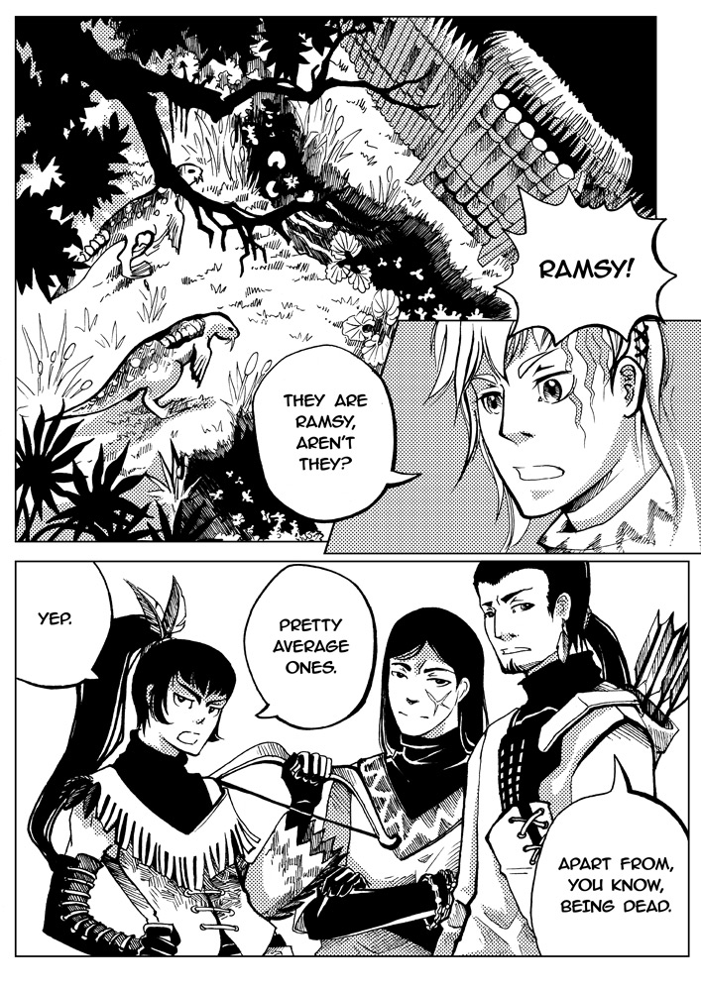

Slide 52
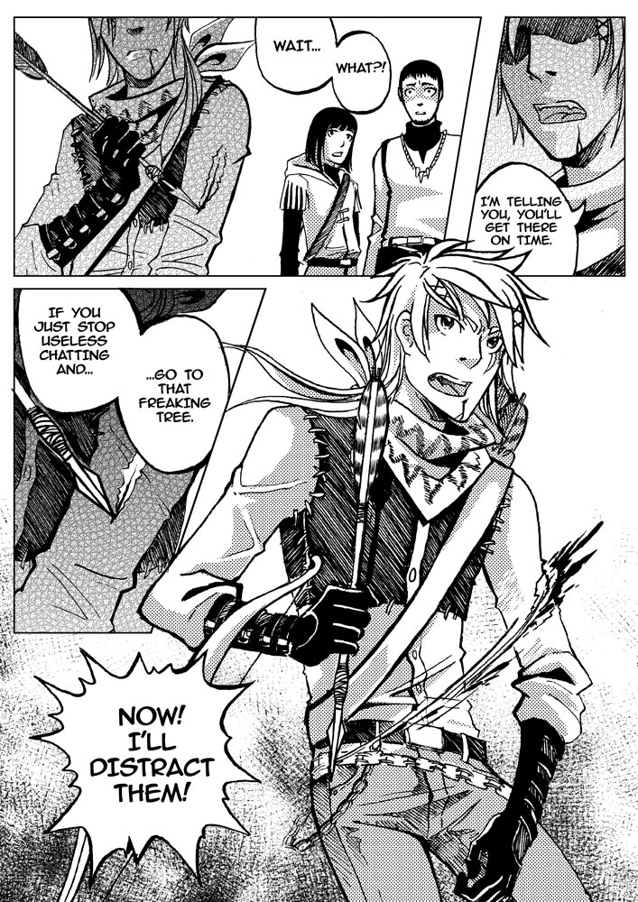

Slide 53
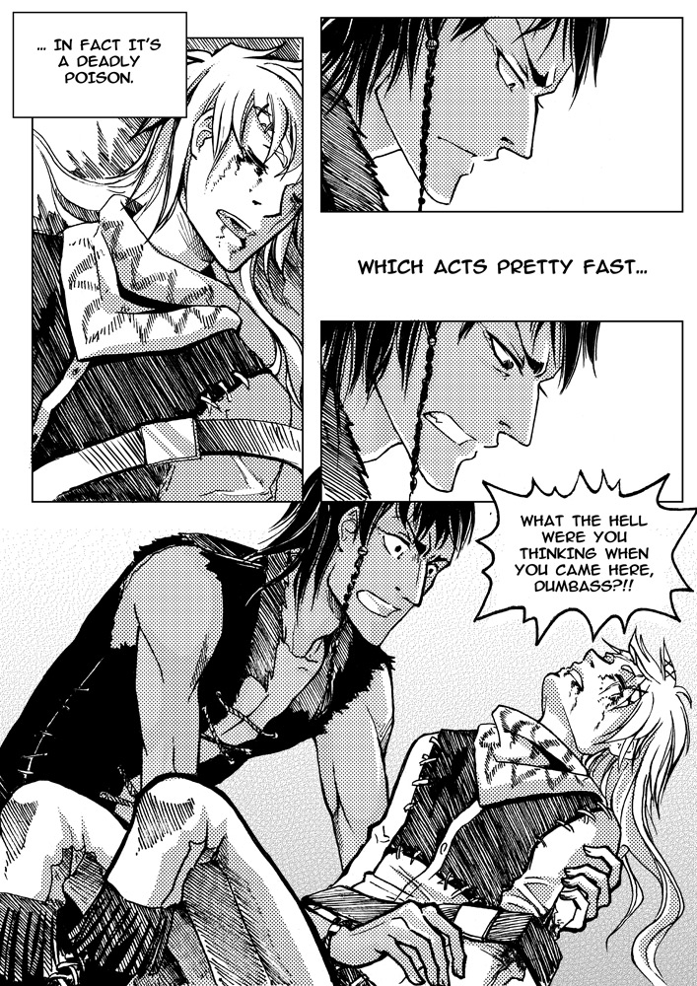

Slide 54
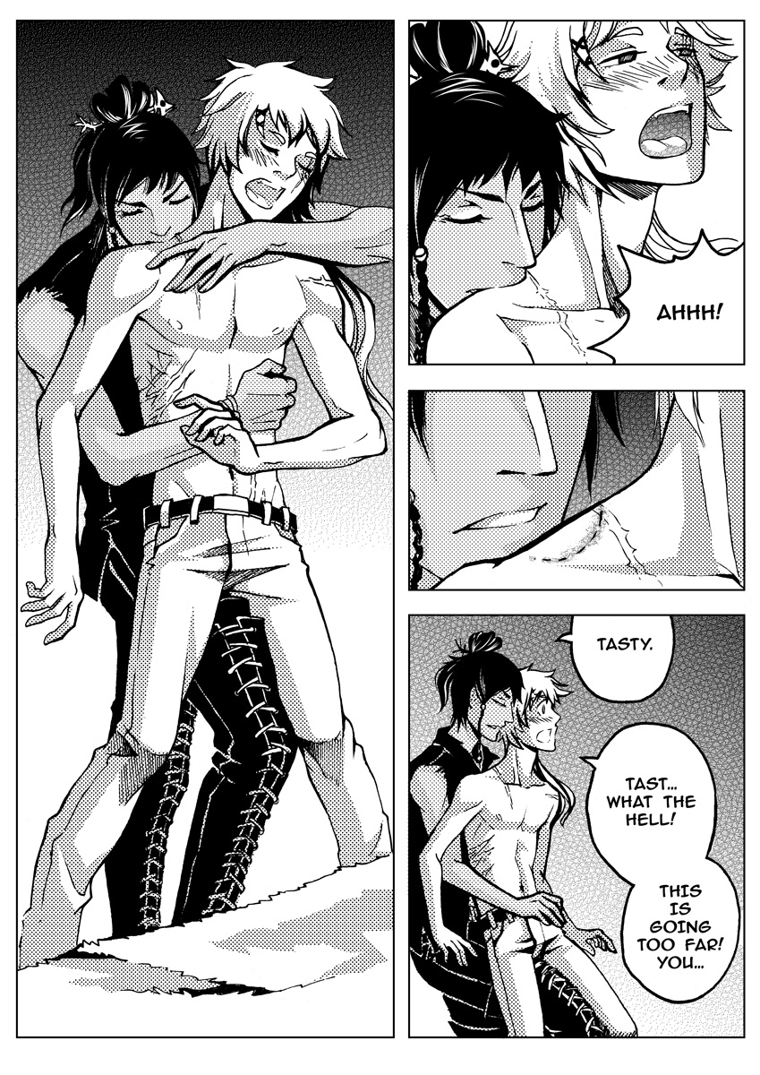

Slide 55
Honorable mentions (That you probably already know)
Artifice and The Young Protectors - http://webcomics.yaoi911.com/
Starfighter - http://starfightercomic.com/
Teahouse - http://www.teahousecomic.com/
The Less Than Epic Adventures of TJ and Amal - http://tjandamal.com/
Venus Envy - http://www.venusenvycomic.com/

Slide 56
Honorable mentions (That you might not know)
The Rock Cocks: http://www.therockcocks.com/
Dumbing of Age: http://www.dumbingofage.com/
Shortpacked: http://www.shortpacked.com/
Go Get a Roomie: http://www.gogetaroomie.com/
Sister Claire: http://www.sisterclaire.com/
Cool Cat Studios: http://www.coolcatstudio.com/

Slide 57
Honorable mentions (That you might not know)
Penny and Aggie - http://www.pennyandaggie.com/
Princess Princess - http://strangelykatie.com/princessprincess/
Robin and the Cat - http://robinandcat.tumblr.com/
Assigned Male - http://www.assignedmale.com/
Discord Comics - http://www.discordcomics.com/
Ménage a 3: http://www.ma3comic.com/
Sticky Dilly Buns: http://www.stickydillybuns.com/

Slide 58
Honorable mentions (That you might not know)
Always Raining Here - http://alwaysraininghere.smackjeeves.com/
Honeydew Syndrome - http://honeydew.smackjeeves.com/
Prince of Cats - http://princeofcatscomic.com/
Purpurea Nox - http://www.purpureanoxa.com/
What Happens in Carpe Diem - http://whic.smackjeeves.com/
Tripping Over You - http://trippingoveryou.com/

