Slide 1
Classic yaoi
Yaoi North 2016
Gryvon, LinChan, tarancet

Slide 2
Kaze to Ki no Uta
17 volume manga by Keiko Takemiya (1976-1984)
60 minute OVA (1987)
Serge and Gilbert are roommates in a French boarding school
Serge is a young viscount who’s trying to make friends with Gilbert
Gilbert at turns tries to seduce and alienate Serge
Deals with coming of age mixed with racism, homophobia, pedophilia, rape, and drug abuse

Slide 3
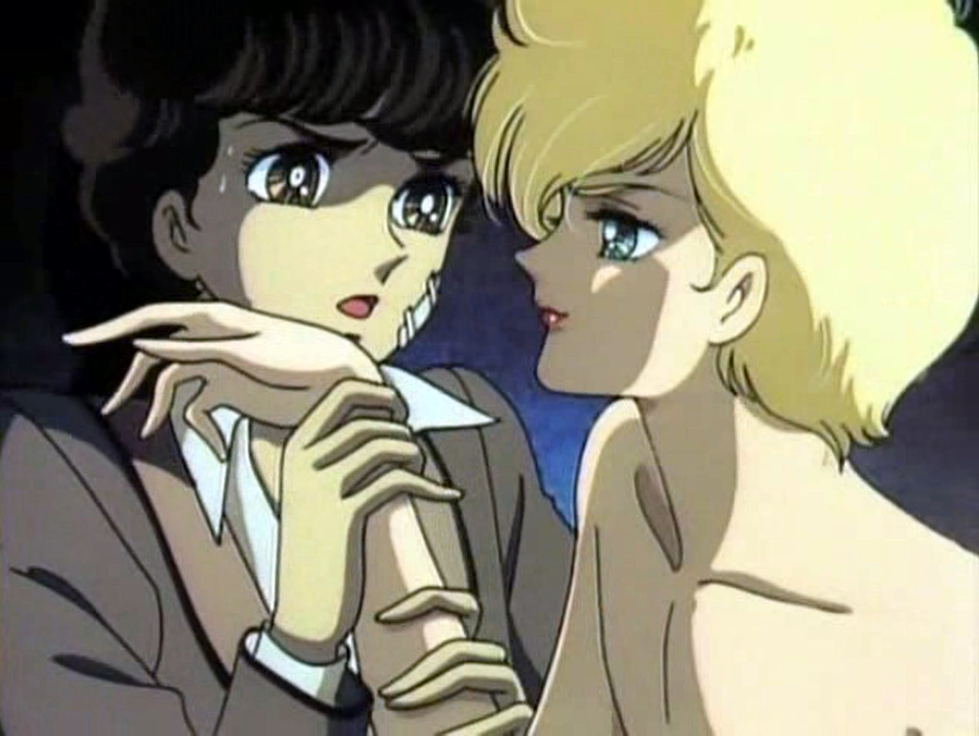

Slide 4
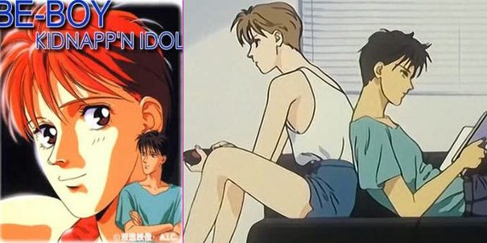
Be-boy Kidnapp’n Idol
OVA released in 1989
Kazuya, a popular Idol Singer, and his best friend Akihiko are kidnapped by a producer who wants Kazuya to sign on to his label
Akihiko saves Kazuya before the producer rapes him

Slide 5
Ai no kusabi
Novel by Reiko Yoshihara
Originally serialized in Shousetsu June from Dec 1986 to Dec 1987
2 episode OVA (1992 and 1994)
Audio Drama Erogenous Dark in 1993
12 episode OVA in 2012, cancelled after 4 episodes

Slide 6
Iason and Riki
Set in a futuristic world where social class is based on hair color
Iason Mink, a “Blondie”, takes Riki, a “Mongrel”, as a Pet
Pets are for sexual display
Others are used as Furniture (castrated)
Iason breaks the rules and has sex with his Pet

Slide 7
Zetsuai 1989
Manga series by Minami Ozaki (1989-1991)
3 OVAs:
Zetsuai 1989 (1992)
Bronze: Cathexis (1994)
Bronze: Zetsuai Since 1989 (1994)
Koji is a damaged rockstar, Izumi is a soccer prodigy
Izumi finds Koji passed out in the trash and takes care of him
Koji becomes obsessed with Izumi

Slide 8
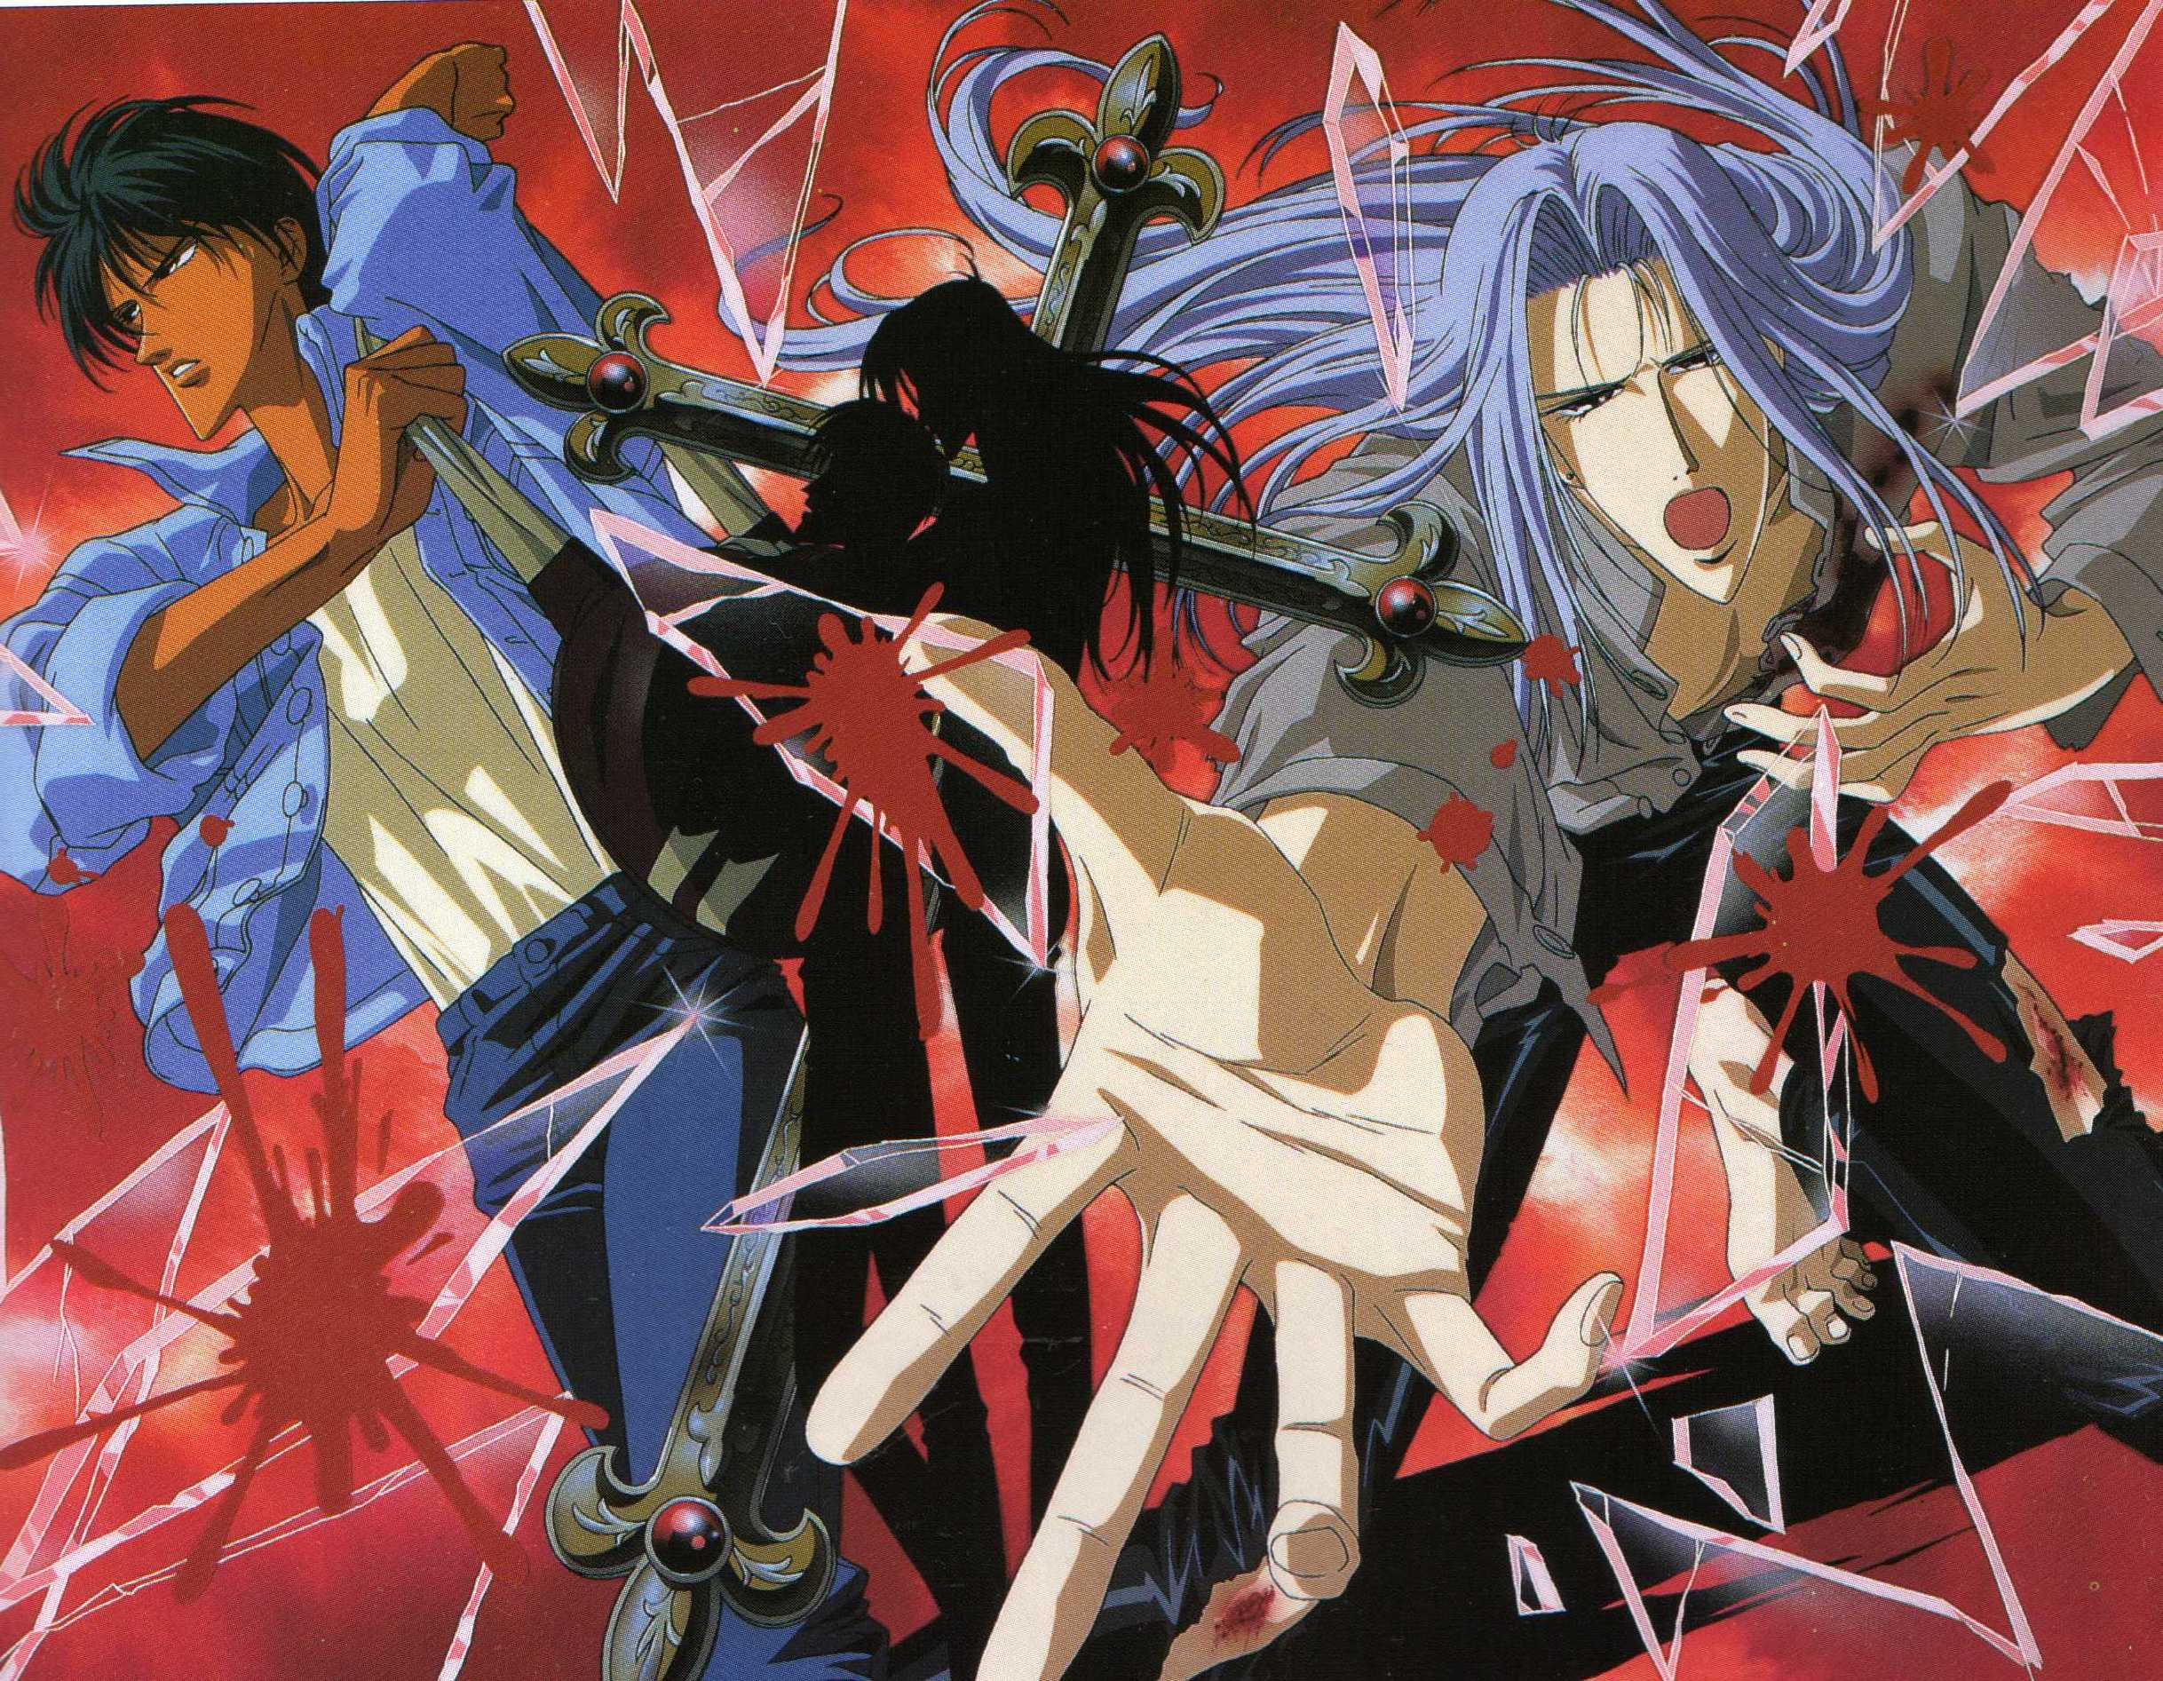

Slide 9
Fish in The Trap
3 volume manga (1993-1994)
30 min OVA (1994)
Matsui falls in love with the high school swim team captain
Joins the team and strikes up a relationship with the captain
Both the captain and Matsui’s friends are against the relationship
(It gets rapey.)

Slide 10
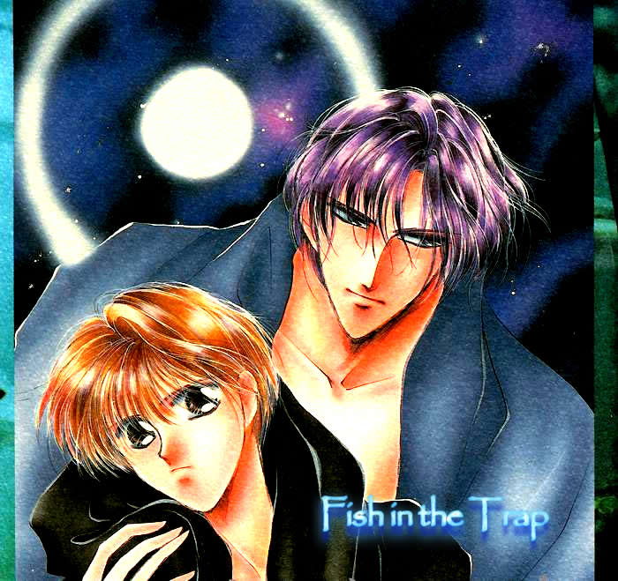

Slide 11
I Shall Never Return
5 volume manga by Kazuna Uchida (1992-1996)
30 minute OVA (1994)
Love triangle between a cheerful young man, Ritsuro, his troubled friend Ken who works as a rent boy, and Ritsuro's girlfriend Moeko.

Slide 12
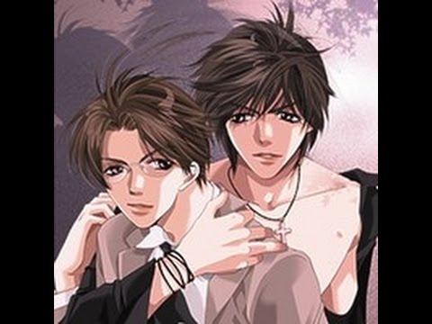

Slide 13
Kizuna
11 volume manga by Kazuma Kodaka (1992 – 2008)
3 OVAs – 2 episodes plus Much Ado About Nothing (1994, 2001)
Kei and Ranmaru have been in love since childhood. Ranmaru is a kendo prodigy and Kei the illegitimate son of a yakuza boss. When Kei’s mother dies, the yakuza come after him. Ranmaru vows to protect him but ends up injured and unable to continue kendo after an accident.

Slide 14
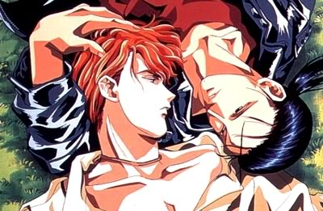

Slide 15
Bad Teacher Equation
10 volume manga by Kodaka Kazuma (1993)
2 episode OVA (1994-1995)
Atsushi enrolls in a new school to be with his childhood crush but it seems like Ma-chan has completely changed personalities! Unbeknownst to him, this Ma-chan is actually the brother of his crush.

Slide 16
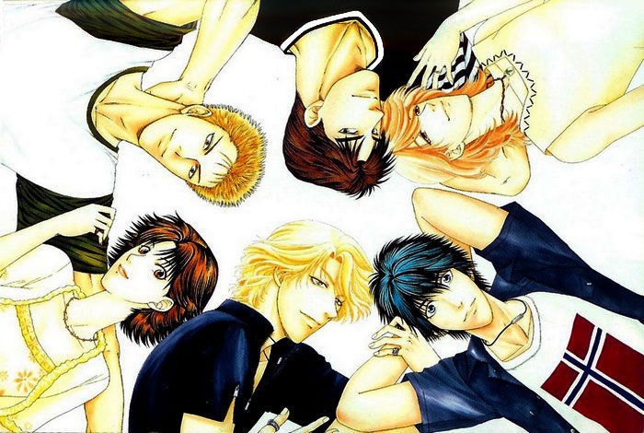

Slide 17
Boku no Sexual Harassment
Novel by Sakura Momo
3 episode OVA released in 1994-1995
Innocent Mochizuki falls in love with his manager Honma
Honma pimps Mochizuki out to help their business prosper
Flashbacks to Mochizuki’s childhood show him transforming into an enlightened adult

Slide 19
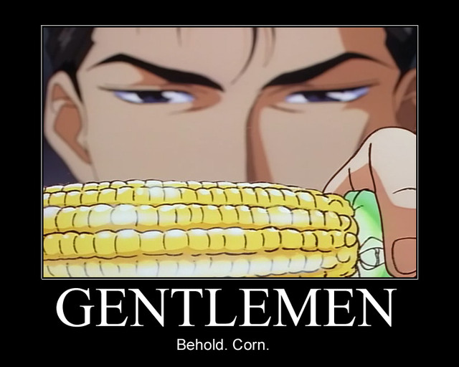

Slide 20
Lesson XX
50 minute OVA (1995)
Based on a short story by Ei Oonagi
Shizuka and Sakura fall in love and angst about it at a boarding school.

Slide 21
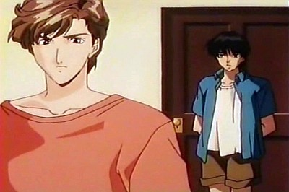

Slide 22
Level C
6 volume manga by Futaba Aoi and Mitsuba Kurenai (1993-1996)
35 minute OVA (1995)
Mizuki is a high school student and male model. Kazuomi is a salaryman who falls in love-at-first-sight with Mizuki.

Slide 23
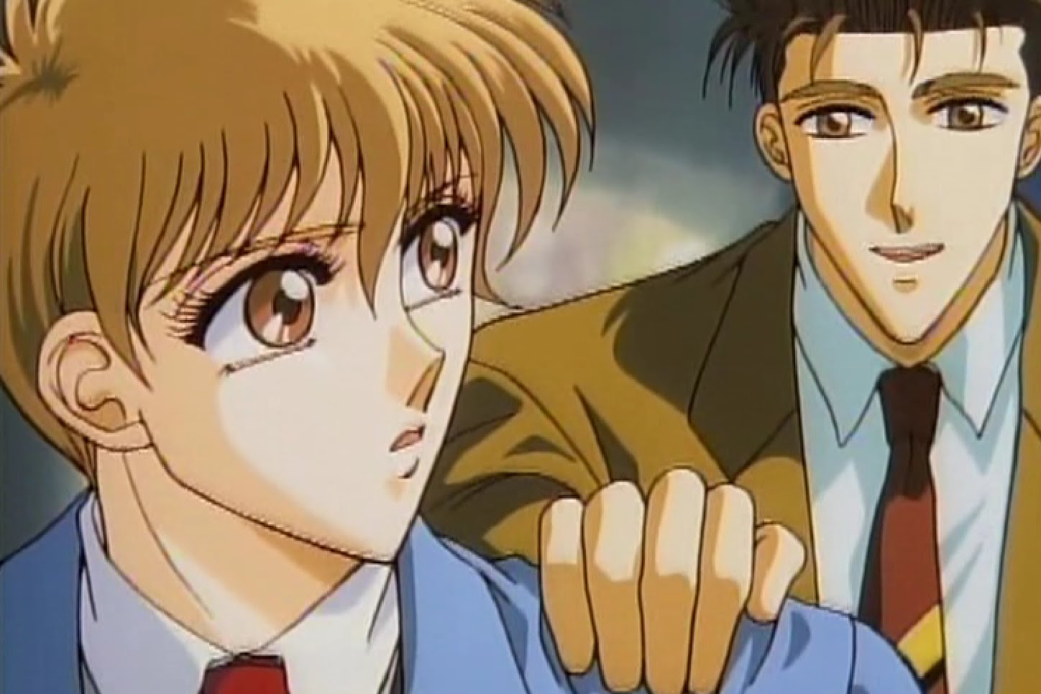

Slide 24
Earthian
4 volume manga by Yun Kouga (1988-1994)
4 episode OVA (1989-1996)
Pairs of angels are sent to Earth to determine good and bad qualities of humanity
If 10,000 bad checks are recorded, Earth is destroyed
Chihaya and Kagetsuya are a pair that fall in love
Homosexuality is forbidden in Eden
Chihaya and Kagetsuya have to choose between their love and duty

Slide 25
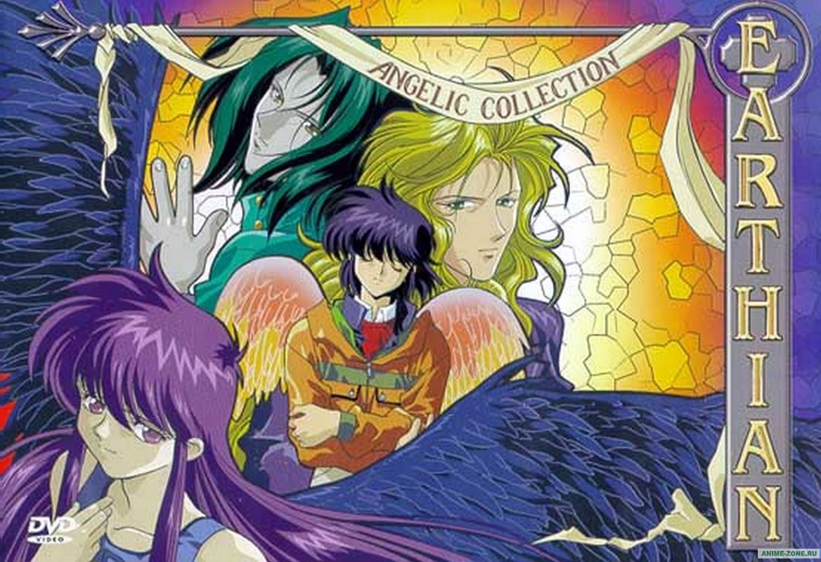

Slide 26
Seikimatsu Darling
30 minute OVA (1996)
Otaka is in love with Takasugi. He thinks confessing his feelings will solve his problems, but it only makes things worse… because Takasugi loves him too. But Takasugi thinks their feelings are too similar. It’s a race to the top. Literally.

Slide 27
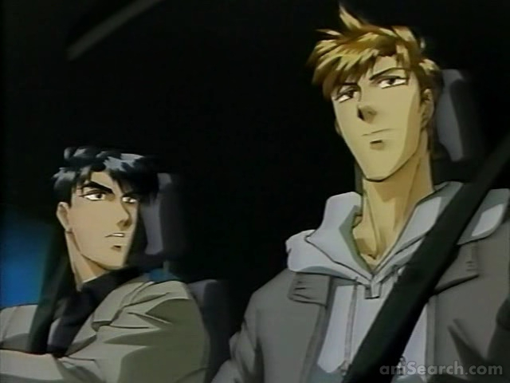

Slide 28
Kimera
2 volume manga by Kazuma Kodaka
48 minute OVA (1996)
Osamu and Jay find Kimera in a biological containment cell
Osamu wants to free Kimera
Alien vampires with male and female genitals who may or may not destroy Earth

Slide 29
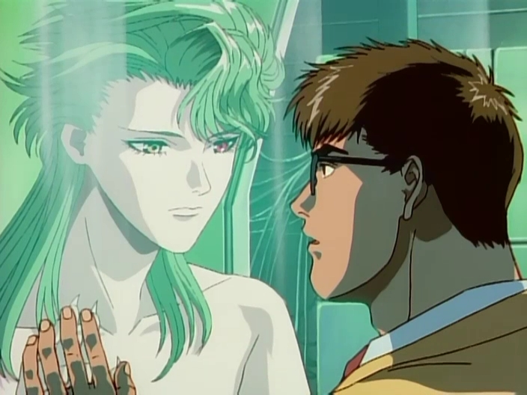

Slide 30
Legend of the Blue Wolves
45 minute OVA (1996)
Jonathan and Leonard are fighters trying to retake Pluto from the alien race that controls it. They fall in love amidst dangerous intrigue and a deadly war.
…Just don’t.
(Very rapey.)

Slide 31
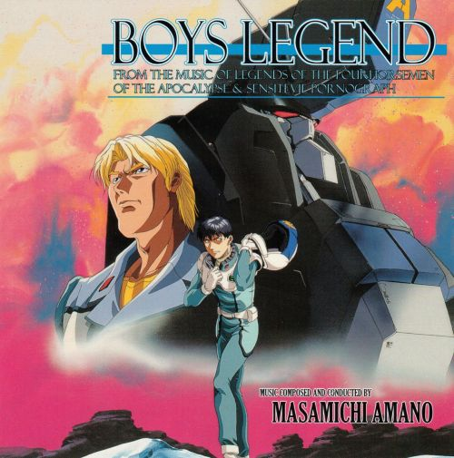

Slide 32
Fujimi Block No. 2 Symphony Orchestra
27 volume novel series by Koh Akizuki
60 minute OVA (1998)
Live action film Cold Front Conductor (2012)
Conductor Tonoin falls in love with concertmaster Morimura, who’s in love with flutist Kawashima, who’s in love with Tonoin
(Yep, this one’s rapey too.)

Slide 33
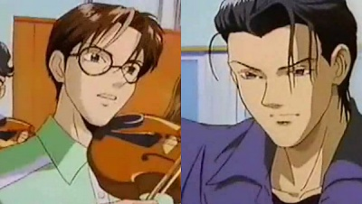

Slide 34
Gravitation
12 volume manga by Maki Murakami (1996-2002)
2 episode OVA (1999)
13 episode TV series (2000-2001)
Rising star Shuichi falls in love with the grumpy romance novelist Yuki Eiri

Slide 35
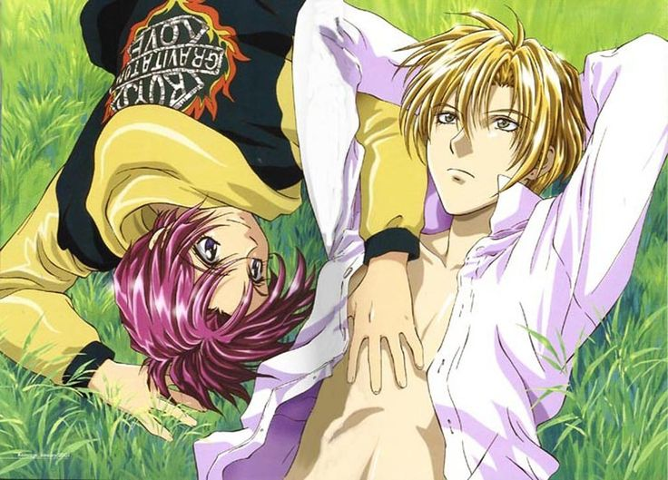

Slide 36
Mirage of Blaze
40 (yes, 40!) volume novel series by Mizuna Kuwabara (1990-2004)
4 volume manga by Mizuna Kuwabara (1994-1997)
13 episode anime (2002)
3 episode OVA (2004)
Takaya just wants to be a normal high school student, until Naoe appears and reveals Takaya is the reincarnation of a feudal lord. Naoe helps teach Takaya how to use his powers to exorcise and fight the spirits of the Feudal Underworld.

Slide 37
